Slide 1

Design Thinking

Slide 2
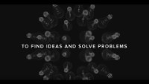
Let us define design thinking

Slide 3

We can do better:
Get into groups and come up with a 30-second definition of design thinking

Slide 4
Your definitions

Slide 5
How is design thinking used?
Business and social context
Start with walking in people’s shoes
Define the problem from their perspective
Always keep their needs in mind

Slide 6
Design thinking framework
Empathize
Ideate
Prototype
Test
Define
Notes:
This is never a linear process, you always need to come back to other phases when things change
This framework looks a lot like others, right? Yes, agile uses similar concepts, as do waterfall and Demming. The difference is in what each framework focuses on.

Slide 7


Empathize
Your group is a company
Your main focus is your company
This phase changes that
Notes:
Your focus is never you. It is always who comes through your doors.
Observe their behavior, see what they need. Otherwise your ideas become less relevant.

Slide 8

Pop quiz
How can you discover what the customer wants?
Notes:
Review of lecture 2, introduce pitfall of market research, AI and data hoarding

Slide 9
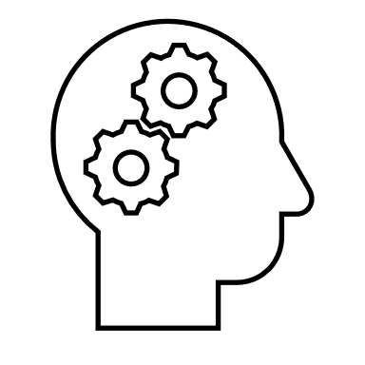

When you empathize
Start fresh
Understand between the lines
Do not press the audience for an answer
Notes:
The yellow Walkman story works here

Slide 10
Questions with emphasis on empathy
Tell me about your experience in this problem
What was the hardest part?
Why was it the hardest part?
Did you solve it? How?
How is it working now?
Notes:
These questions help you identify the problem, and then the solution.

Slide 11
Design thinking framework - Empathize
Empathize
Who are the users?
What do they care about?
Notes:
This framework looks a lot like others, right? Yes, agile uses similar concepts, as do waterfall and Demming. The difference is in what each framework focuses on.

Slide 12

Define
You got the insight
You have the POV of customers
You now need to know what they need

Slide 13
Create a problem statement
A statement that defines your customer’s (and your) goal
It has to be specific to the insight you gain
It has to be general enough to allow room for your innovation

Slide 14
Let’s make one
Read the excerpt below, and in your group, make a problem statement.
Remember that it must be broad enough to address a need, but specific enough to make it achievable
Road Tech Inc is a company that develops GIS software for coordinating road construction and renovation projects. Companies involved in road works coordinate their efforts to ensure traffic flow is not heavily compromised during the works. Through this tool, an end user can highlight sections of road that are closed for work, the detour to which traffic will be directed, and the dates of work, on a map using the GIS application programming interface. This can be used by construction companies, municipal and provincial governments, and businesses affected by the software.

Slide 15
Design thinking framework - Define
Empathize
Define
Who are the users?
What do they care about?
What are they looking for?
Notes:
This framework looks a lot like others, right? Yes, agile uses similar concepts, as do waterfall and Demming. The difference is in what each framework focuses on.

Slide 16

Ideate
Now you know the problem
Time to come up with a solution
How?

Slide 17
How do you conduct a brainstorming session?
Divergent thinking (solo)
Consider any and every idea in your head
Having the chance to think for yourself prevents
Convergent thinking (team)
Share your ideas with your team
You can all mix and modify your individual ideas

Slide 18
Try it
Spend ten minutes away from the screen
Look at your surroundings
What can you think of when I say…
Write them down
Come back in ten minutes and join a breakout room
Share your thoughts and come up with more as a team

Slide 19
Design thinking framework - Ideate
Empathize
Define
Ideate
Who are the users?
What do they care about?
What are they looking for?
What can we do about it?
Notes:
This framework looks a lot like others, right? Yes, agile uses similar concepts, as do waterfall and Demming. The difference is in what each framework focuses on.

Slide 20

Prototype
So you have an idea of what you need to do
Do it

Slide 21
Prototyping
Build a representation of your idea
It can be a full working model
It can also be a cardboard cutout
It can even be paper, or a drawing

Slide 22
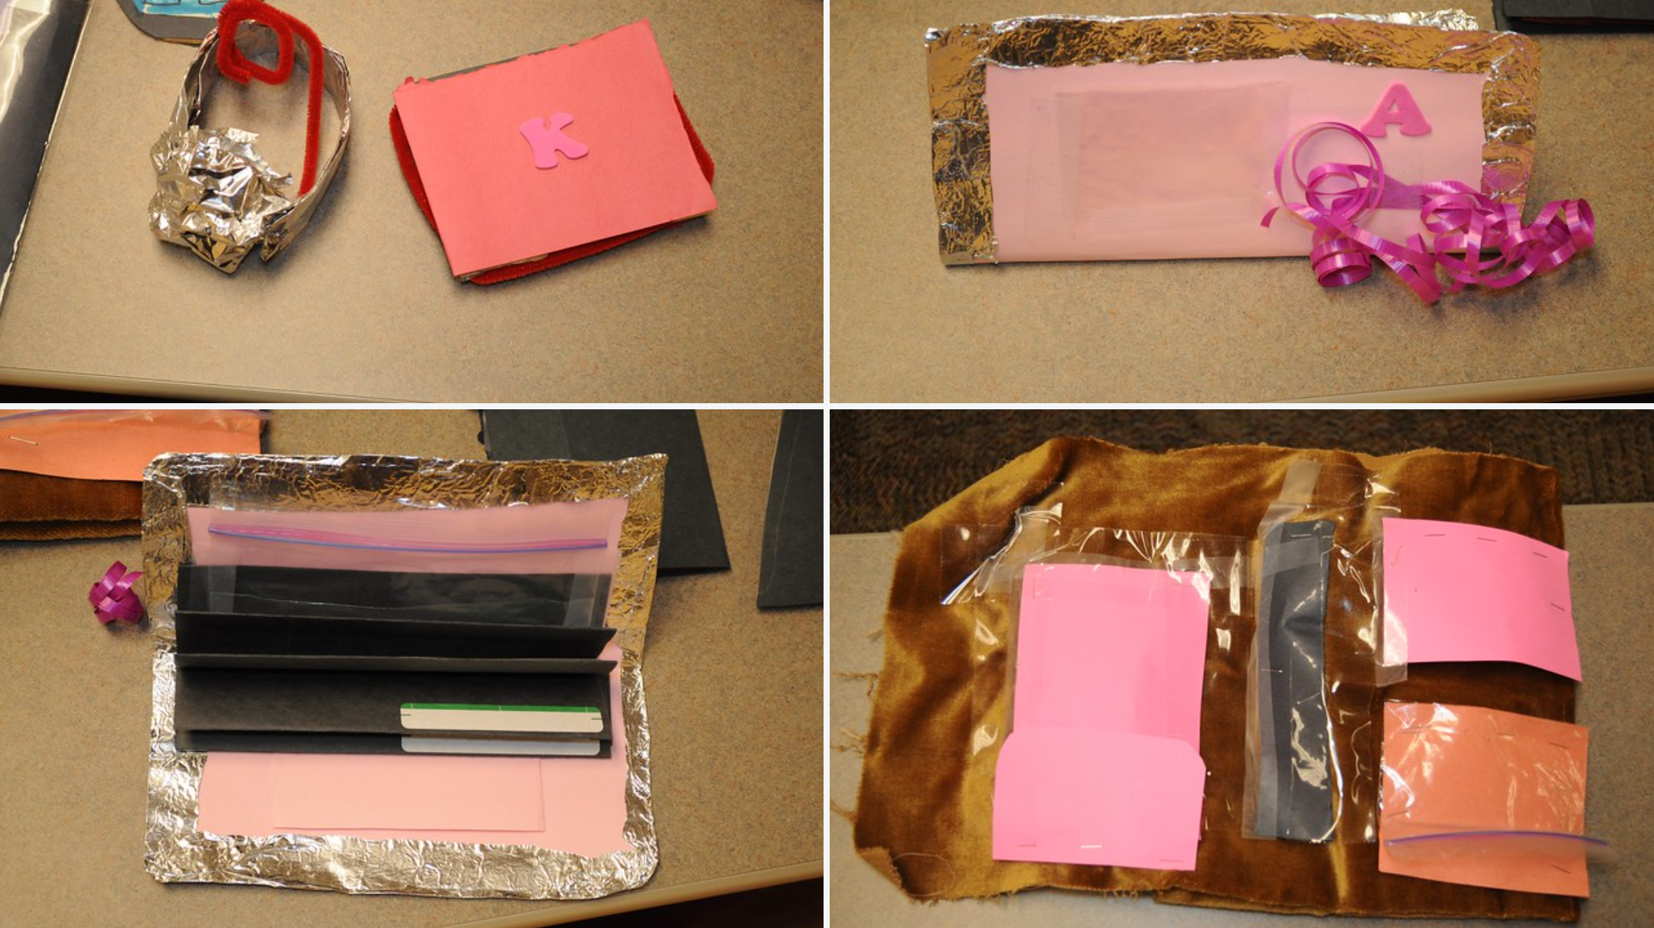
Prototype examples
Courtesy of Dr. John Nash via Flickr
Notes:
Defined as a preliminary version of your design

Slide 23
Why?
Explore how your idea will work
Show something to your customers
See their reactions to the prototype
Notes:
Recall the Yellow Walkman story
Mention the role playing advantage
McDonalds movie story?

Slide 24
Remember
It needs to look like the real thing
It needs to resemble the minimum viable product

Slide 25
Design thinking framework - Prototype
Empathize
Define
Ideate
Prototype
Who are the users?
What do they care about?
What are they looking for?
What can we do about it?
What should it look like?
Notes:
This framework looks a lot like others, right? Yes, agile uses similar concepts, as do waterfall and Demming. The difference is in what each framework focuses on.

Slide 26

Test
Show and tell
Review your design based on feedback
Notes:
This is where the customer finally puts their hands on the yellow Walkman
It is important to let them play with the prototype without your input

Slide 27
Rules of prototype testing
DO NOT tell them how to work your prototype
A prototype is NOT A BABY
NO ONE must know that it is yours

Slide 28
Questions to ask
Is this what you imagined?
What works for you?
What isn’t working?
How do you do things without this prototype?
Notes:
This is a chance to see what they think, but also, you get another chance to understand your customer.

Slide 29
Design thinking framework - Test
Empathize
Define
Ideate
Prototype
Test
Who are the users?
What do they care about?
What are they looking for?
What can we do about it?
What should it look like?
Do we have a solution on our hands?
Notes:
This framework looks a lot like others, right? Yes, agile uses similar concepts, as do waterfall and Demming. The difference is in what each framework focuses on.

